Slide 1
Team Member Self Service
Quick Access Guide
ReadyPay Online
TM

Slide 2
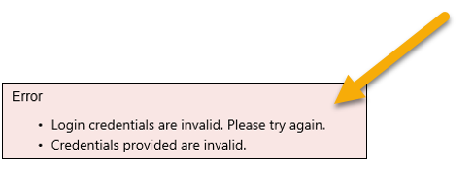
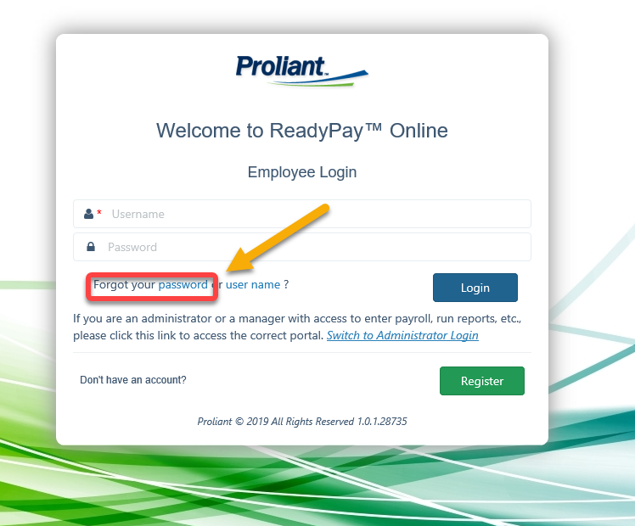
Logging in to ReadyPay
TM
Did you try logging on and got this message?
Click Here! https://new.readypayonline.com/Proliant/Login/Login.aspx?AutoLogout=True
No big deal! Click “Forgot your password”
Enter your username and password, then Click Login
3

Slide 3
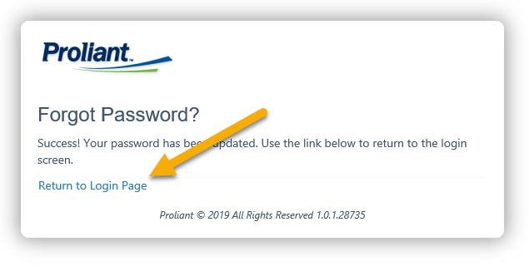
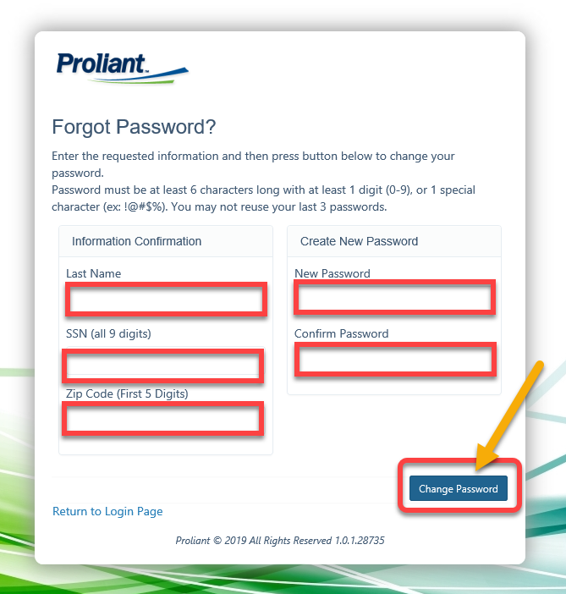
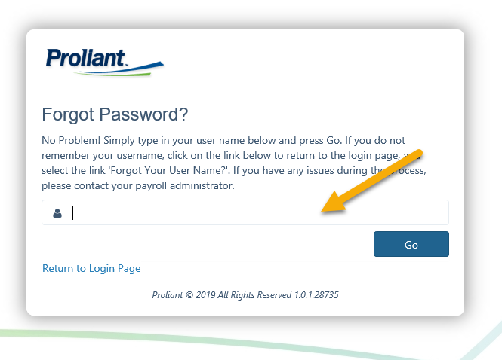
Logging in to ReadyPay
Enter your username and Click GO.
Once completed with success message Click Return To Login Page
It will bring you to this page. You need to fill in all red areas then Click Change Password

Slide 4
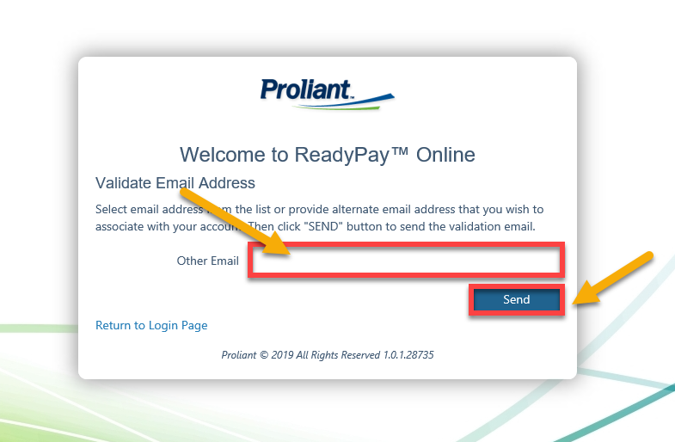
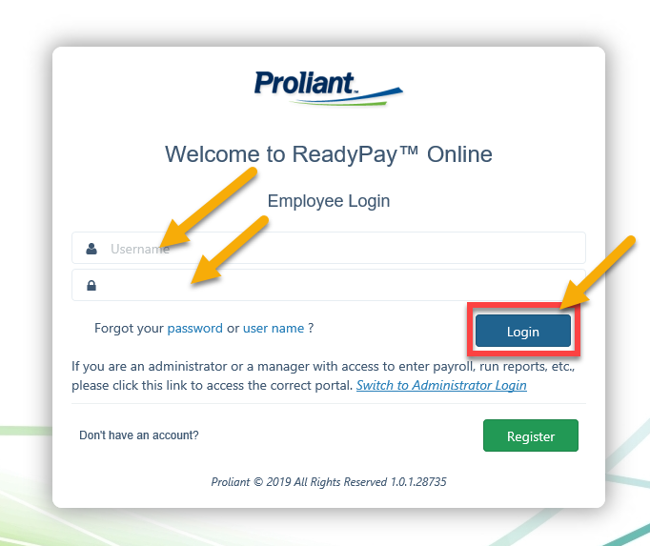
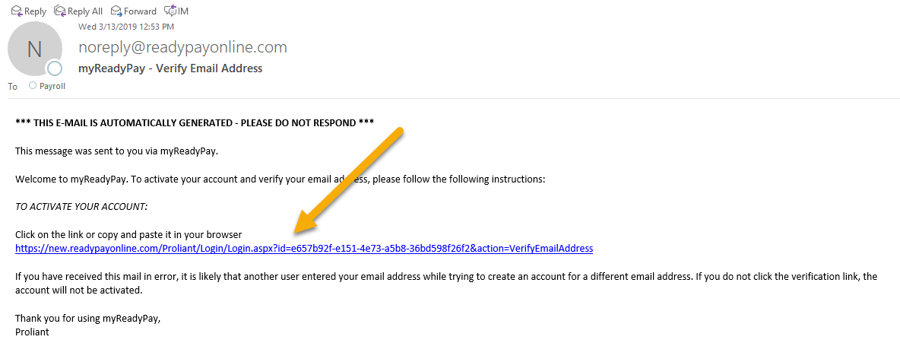
Logging in to ReadyPay
If you have not validated your email before changing your password, you will get this screen. Enter your email and then Click Send
Enter your username and newly created password. Then Click Login.
Click The Link in the email. It will route you back to the login page

Slide 5
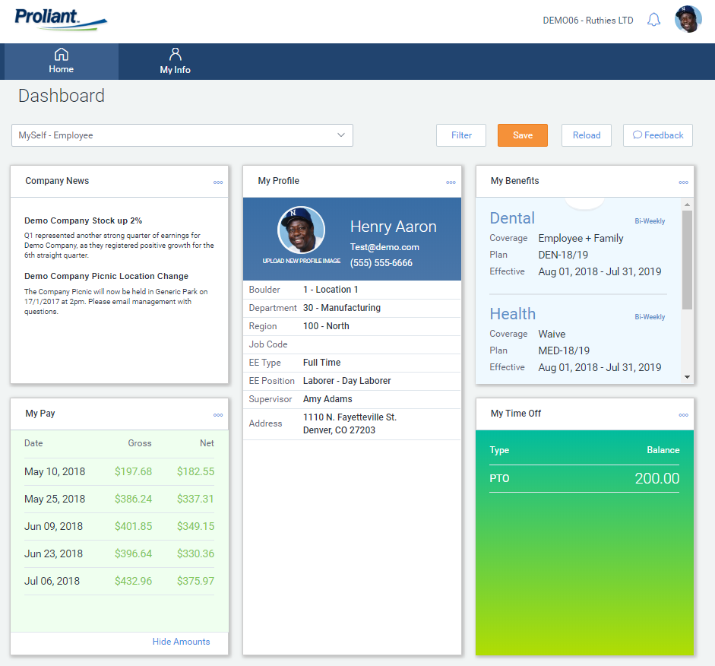
Logging in to ReadyPay
If you see this screen, Success! This is your landing page or dashboard. This page is customizable to your preferences.
Enter username and password you created. Click Login.
Issues or Questions?? Email us at Payroll@pacificbells.com

Slide 6
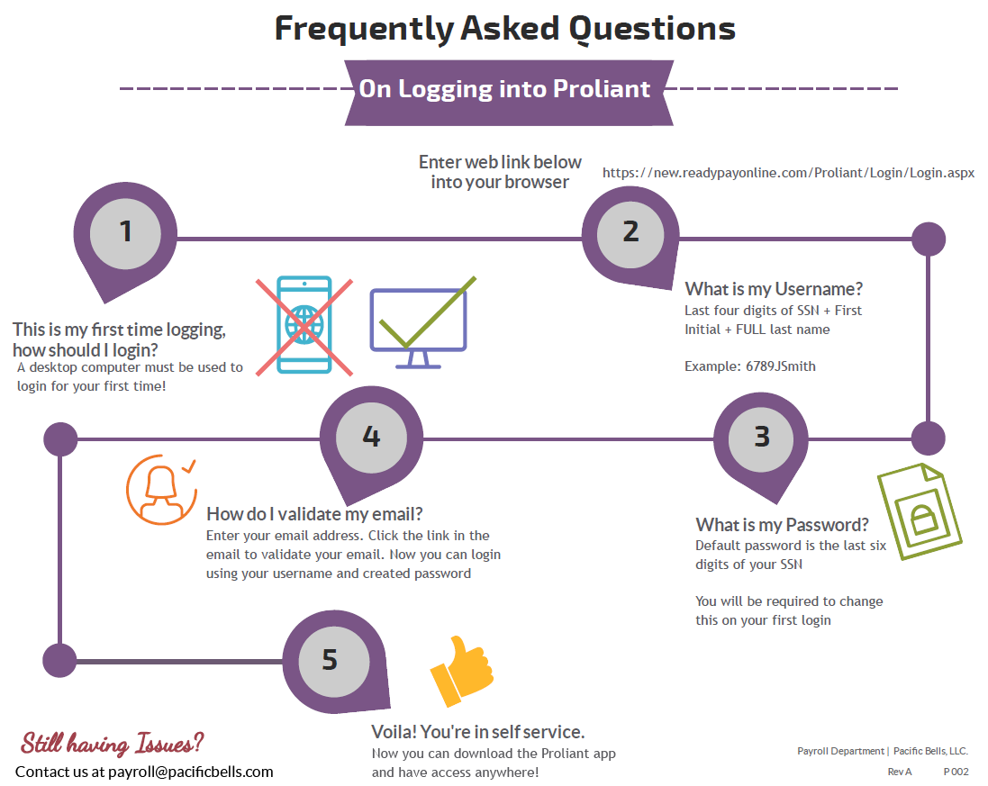
Don’t forget to download the app!!

Slide 7
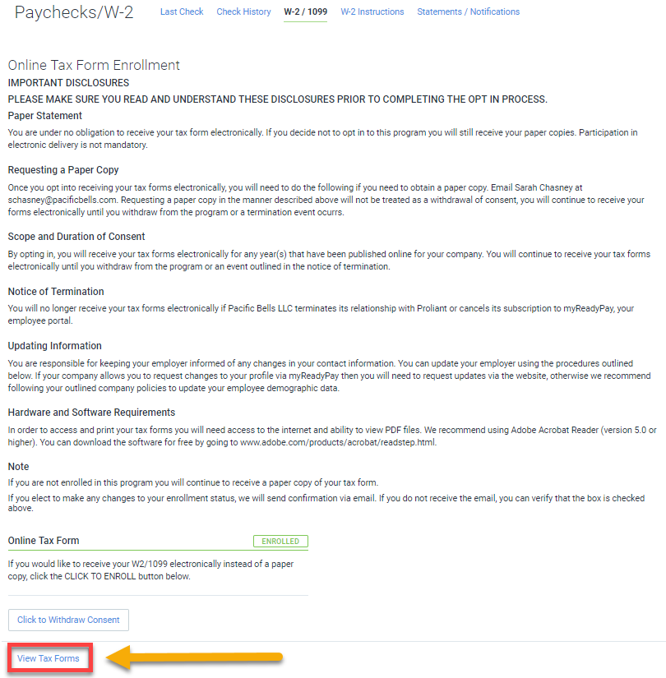
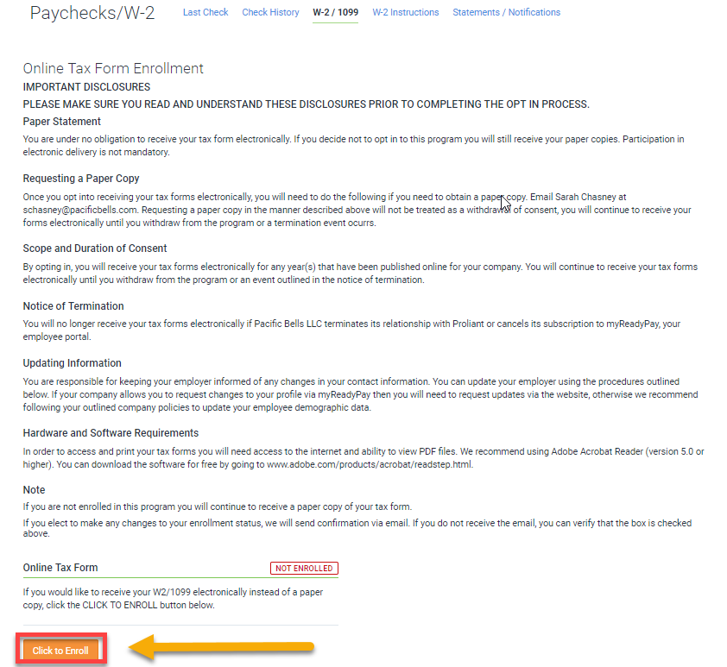
Enrolling and Downloading your W-2
Hover over My Info then Paychecks/W-2 and W-2/1099.
Scroll to the bottom of the screen and click on ‘Click to Enroll’
A pop up will appear asking if you are sure you want to enroll, click OK.
The button ‘View Tax Forms’ will be come available and clickable.

Slide 8
Once you validate your email address and log on, you will be brought to the page below.
Scroll to the bottom of the screen and click on ‘Click to Enroll’
A pop up will appear asking if you are sure you want to enroll, click OK.
The button ‘View Tax Forms’ will be come available and clickable.

Slide 9
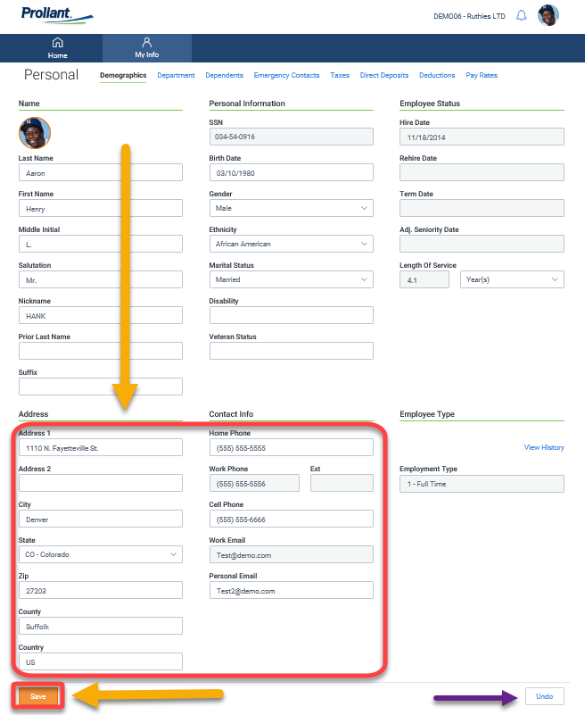
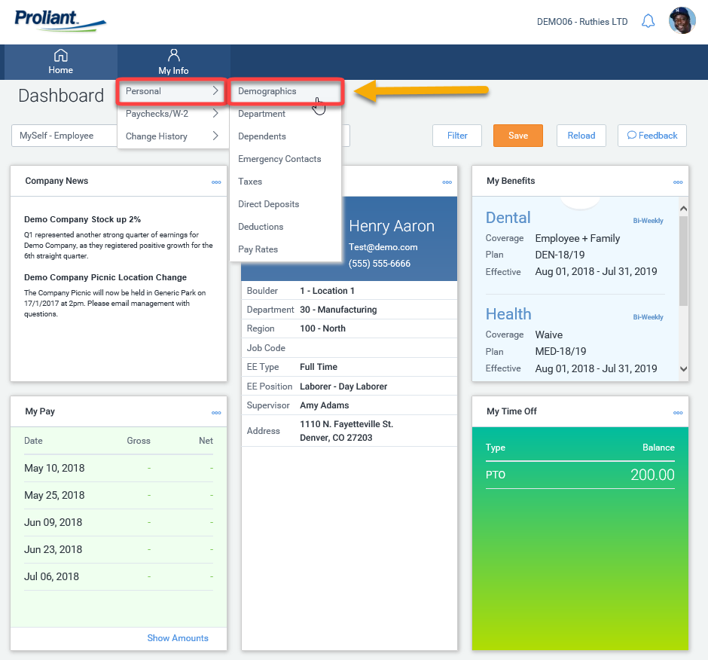
Viewing & Updating Personal Information
Use the boxes that are not greyed out to update your address and personal information.
When complete, click Save.
Make a mistake? No big deal! Just click Undo where the purple arrow is.
Hover over My Info then Personal Information and Demographics.

Slide 10
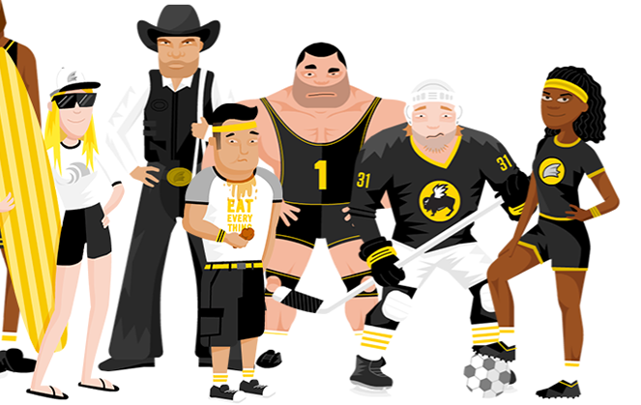
We’re here to support YOU!
Sarah Chasney
Payroll Manager Schasney@pacificbells.com
Payroll Team PayrollWings@pacificbells.com

